Slide 1
Asia

Slide 2
Over view
Before WWII
Most Asian countries were colonies of European powers.
During WWII
Some Asian countries supplied troops.
Some Asian countries gave supplies and weapons.
Some Asian countries were invaded/occupied
After WWII
Nationalist groups in Asian countries grew stronger.
Transition- Asian countries moving from colonies to independence.
*Japan, of course, was an aggressive imperialist nation before and during WWII

Slide 3
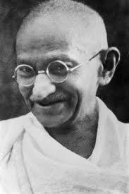
India
Had been a British colony since the 1700s
WWI lead to more Indians calling for their independence, but the movement eventually split into two main groups
Group | Hindus | Muslims
Leader | Mohandas Gandhi | Muhammad Ali Jinnah
Organization/ Motivation | “Quit India” | Muslim League
Goal for India | Independence form Britain | Partition of India
Outcome | Independent India | Creation of Pakistan

Slide 4
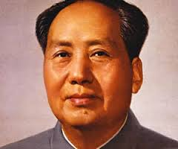
China Under Mao
Mao’s Programs and Their Affect on China
First Five Year Plan | Great Leap Forward | Cultural Revolution
transferred farmland from landlords to peasants pooled small farms into collective farms and state farms agricultural and industrial output increased | threatened Mao’s leadership people were forced to move to communes industrial output decreased food shortages | had a disastrous effect on China’s economy Red Guard rampaged agricultural and industrial production fell drastically

Slide 5
China After Mao
Four Modernizations- new plan by Deng Xiaoping, who had become the leader of the newly ruling moderate party
moved China towards a market economy, with new technology and trade with the west
many wanted “fifth modernization”- democracy
hundreds of thousands gathered at Tiananmen Square, wanting an end to government corruption, more say in government, and better conditions in universities
refused to leave and eventually hundreds were killed and thousands wounded by the Chinese military
Tiananmen Square Massacre shocked the West and became a huge setback to previous economic gains
http://www.guardian.co.uk/world/video/2008/jun/04/tiananmen.anniversary.china

Slide 6
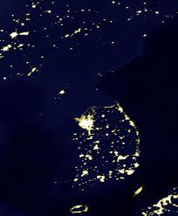
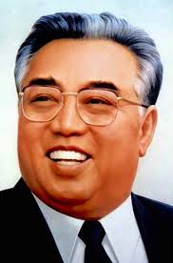
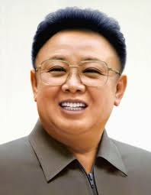
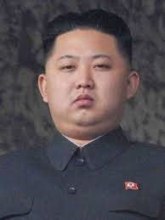
Korea
Why was Korea divided?
How have the 2 Koreas developed since 1953?
http://www.cbsnews.com/video/watch/?id=50136263n
http://www.cbsnews.com/video/watch/?id=7403218n

Slide 7
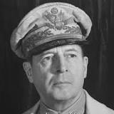
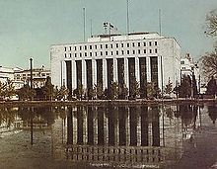
Japan
How did Japan recover after World War II?
Allied occupation, or SCAP (1945-1952)
New constitution (MacArthur Constitution) imposed
Reduction of Emperor’s power
Armed forces for self-defense only
The Dai-Ichi Seimei Building served as SCAP headquarters, 1950

Slide 8
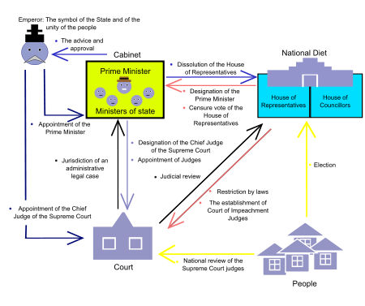
Japanese Constitution http://www.learn360.com/McGrawHillPlayer.aspx?ID=693241&pt=1
Modeled on the U.S. constitution
Universal suffrage
Three branches of government
Direct election of the Diet,
or Parliament
It did retain some elements
of their nineteenth century
political system, such as their
political parties.

Slide 9
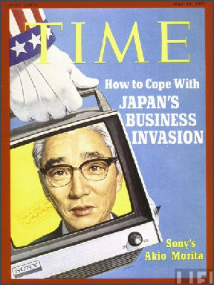
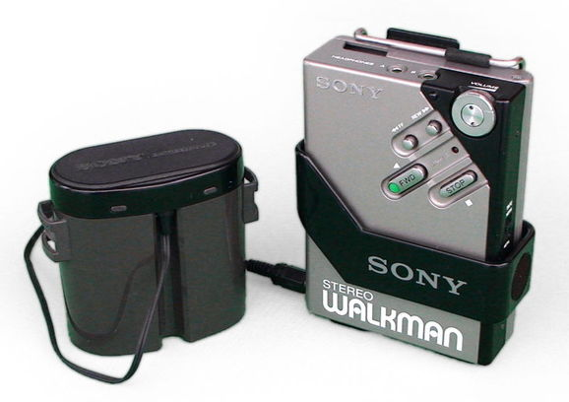
Japan’s Economic Reform (Another Miracle Recovery) http://www.learn360.com/McGrawHillPlayer.aspx?ID=693242&pt=1
Divided large tenant farms into small, private farms
State capitalism
Government set price and wage policies
Established ties between large companies and provided $ for major industries
Converted military industries to consumer goods, and became an industrial giant
Highly skilled workforce eventually led the world to become dependent on Japanese technology

Slide 10
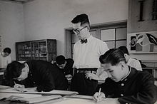
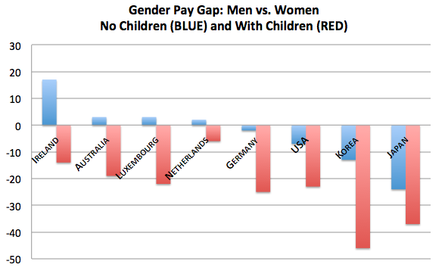
Japan’s Social Policies (New and Traditional)
New
Traditional
Emperor was not divine
War was not a natural right
New competitive educational system stressing individualism and testing
Continued emphasis on strong work ethic
Women have not gained equal treatment (average salary still 60% of men and do not enjoy senior level jobs)

Slide 11
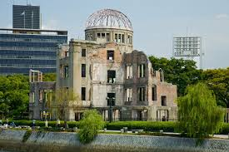
Japan’s Foreign Policy
U.S. wanted Japan to become more militaristic to help combat spread of communism
Japan refused
By late 1980s, Japan was giving more aid than any other nation in the world.
Hiroshima Peace Memorial—keeps track of every new nuclear test in the world

Slide 12
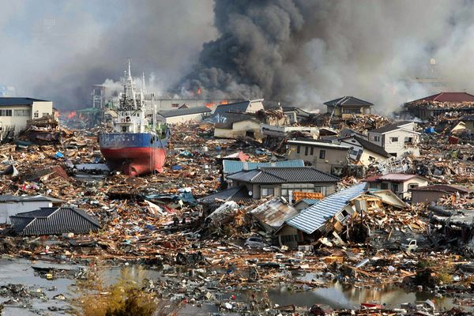
Recent Challenges in Japan
Recession and aging of population: The collapse of the Japanese real estate market in the 1980s led to recession in the 1990s. Putting further strain on the economy has been the large number of people reaching retirement age.
Deflation and its effects: The slowing of economic growth led to a decline in consumer confidence and spending; consumers have also noted a decline in the quality of Japanese manufactured products. In 2010, China passed Japan to become the world's second largest economy.
Tsunami: In March 2011, an earthquake produced a tsunami that caused widespread devastation, including damage to a nuclear power plant that resulted in releases of radioactive gas. Death tolls were over 15,000 people.
http://video.nationalgeographic.com/video/news/japan-tsunami-2011-vin

Slide 13
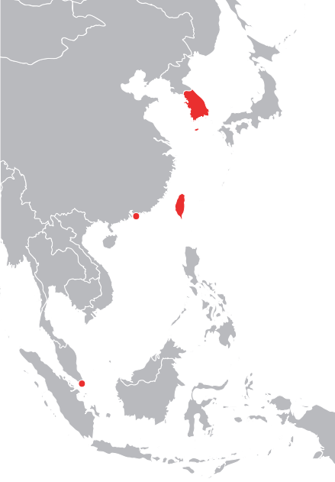
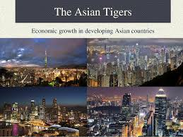
Asian Tigers
South Korea, Taiwan, Singapore, Hong Kong
Imitated Japan’s economic growth
Built successful industrial societies

Slide 14
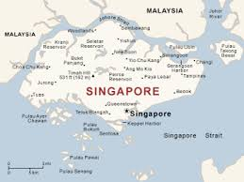
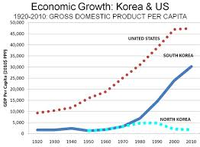
Asian Tigers
South Korea: After the dictatorial president Syngman Rhee was forced to retire in 1960, Park Chung Hee was elected president and began to strengthen the South Korean economy. South Korea gradually emerged as a major industrial power in East Asia.
Singapore: After becoming an independent state, Singapore emerged as one of the most advanced economies in Southeast Asia.

Slide 15
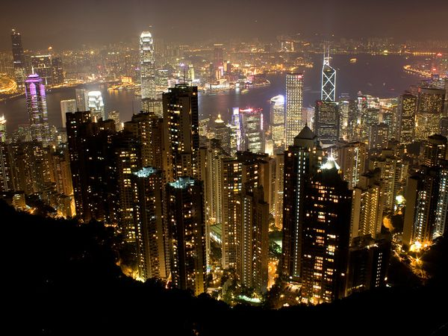
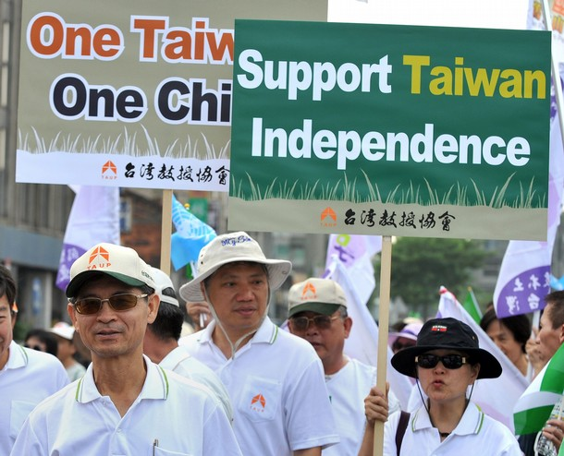
Asian Tigers
Hong Kong: Like Singapore, Hong Kong became an economic powerhouse. In the 1980s, Great Britain agreed to return control of the city to mainland China in 1997. In turn, China promised that Hong Kong would enjoy a high degree of economic freedom for the next 50 years.
Taiwan's postwar development: Under the protection of American military forces, Chiang Kai-shek used foreign aid and the efforts of the people to build a modern industrialized society.
Independence or unification?: A major issue for Taiwan is independence versus unification with mainland China, which considers Taiwan part of its territory.

Slide 16
Education
These countries, and others, have copied Japan’s rigorous education system, and often lead the way on international tests.
http://www.cnn.com/2013/12/03/opinion/education-rankings-commentary-schleicher/

Slide 17
Post-Colonial Governments
Indonesia
Dutch resistance: The Netherlands was less willing than Great Britain to part with its colonies in Asia. The United States persuaded the Netherlands to allow Achmed Sukarno and his Nationalist Party to take control of Indonesia and lead it as an independent country.
System of government: Sukarno became Indonesia's president in a parliamentary government. He later dissolved parliament and ruled on his own. He was eventually overthrown by the military.

Slide 18
Post-Colonial Governments
Burma/Myanmar: Burma, also known as Myanmar, has been controlled by an authoritarian military government since the early 1960s. Nobel Peace Prize winner Aung San Suu Kyi has led people opposed to the government and in favor of democratic rule. She has spent much of her life in government detention.
http://video.about.com/asianhistory/Profile-of-Aung-San-Suu-Kyi.htm

Slide 19
Post-Colonial Governments
Vietnam and Cambodia: After the Vietnam War, the victorious North Vietnamese leadership began to rebuild the devastated country. Following the example of Vietnam, the neighboring countries of Cambodia and Laos installed Communist governments. Pol Pot took control of the Cambodian government and became one of the most brutal leaders in the history of the region, ordering the killings of more than a million people.
http://video.about.com/asianhistory/Profile-of-Pol-Pot.htm

Slide 20
Post-Colonial Governments
Philippines: The rule of Ferdinand Marcos from the mid-1960s to the mid-1980s was characterized by corruption and the violent repression of his opponents. After Marcos, the Philippines continued to struggle with economic and social problems under democratic rule.
http://abcnews.go.com/Nightline/video/imelda-marcos-3000-pairs-shoes-9044413

Slide 21
Women in Post-Colonial Asia
Women's rights and roles: In India and in Southeast Asia, women were granted extensive political rights after independence. Some women have become government and business leaders

