Slide 1
Origins of the Industrial Revolution
or
Where Did All of These Machines Come From?

Slide 2
Pre-Industry
Middle Ages = Traditional Farming
Most farm land was communal land, meaning peasants worked on the same large, open piece of farmland. Fences / property lines not used—empty strips of land often separated farms.
Disadvantages:
  The land between the strips was wasted.
  No fences allowed cattle to wander off of farmland.
  Peasants lives were at the subsistence level—barely produced enough food to survive.

Slide 3
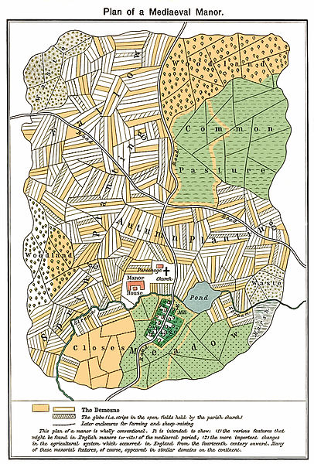
Traditional English manor

Slide 4
Pre-Agricultural Revolution
Middle Ages:
Middle Age farmers specialized in one crop, but found that after several years, crops began to die
To solve this problem, 2 of 4 fields were left fallow (empty) to regain nutrients
This is a very inefficient use of land.
Fallow | Wheat
Wheat | Fallow

Slide 5
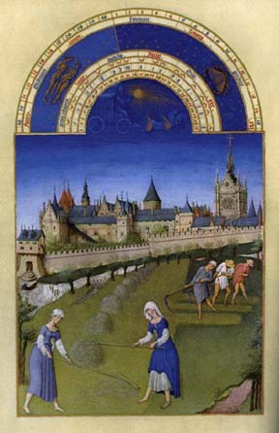

Slide 6
Agricultural Revolution (1600’s)
Crop Rotation
Wheat
Corn
Turnips
Clover

Slide 7
Crop rotation
Each field is planted with a different crop, and crops rotate through each field once every 4 years
Fields depleted of nutrients by one crop are replenished by planting different crops.
Fields not left inefficiently fallow.
Enclosure movement
Wealthy landlords fenced in pastures, creating modern concept of property ownership.
Villages lost common lands and political power as landlords became more powerful.

Slide 8
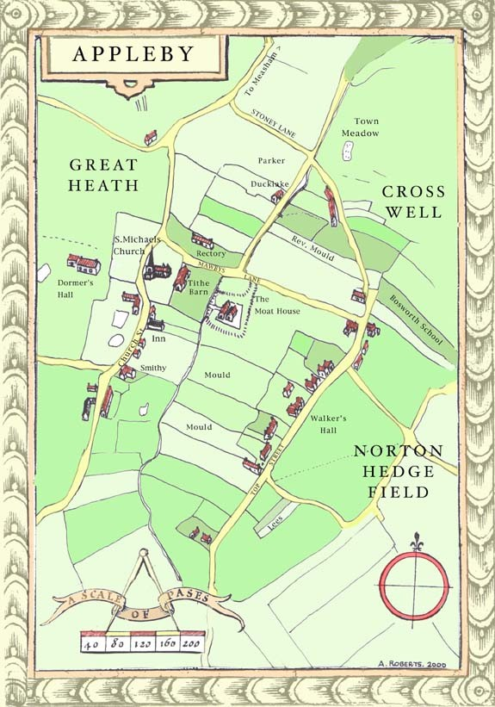

Slide 9
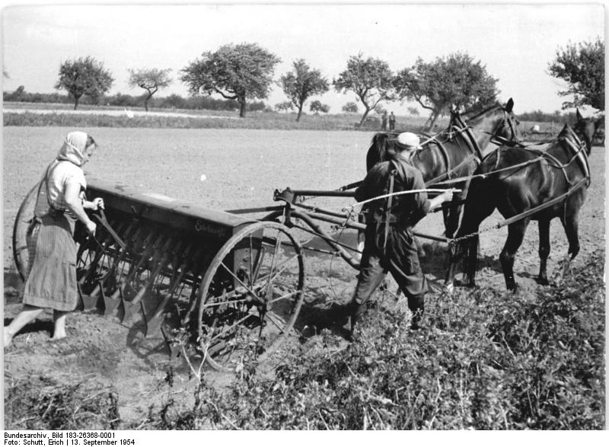
The 1st Inventions of the Industrial Revolution were part of the Agricultural Revolution
Jethro Tull invented a seed drill that planted seeds efficiently.
Results
More food available
Population increased
New crops: corn and potato

Slide 10
The Cottage Industry
Merchants’ roles in cottage industry
Supplied materials - wool and cotton (textiles) to cottages to be prepared and spun.
Took supplies from spinning cottage to weaving cottage to dying cottage.
Merchants sell product for more than the material and labor costs—make a profit, become part of middle class
Steps in cottage industry production
Purchase or Gather Supplies (cotton / wool)
Spinning House
Weaving
House
Dye
House
Merchants pick up and sell to markets / stores

Slide 11
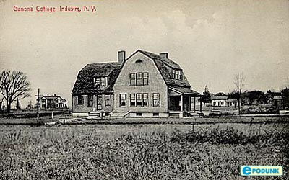

Slide 12
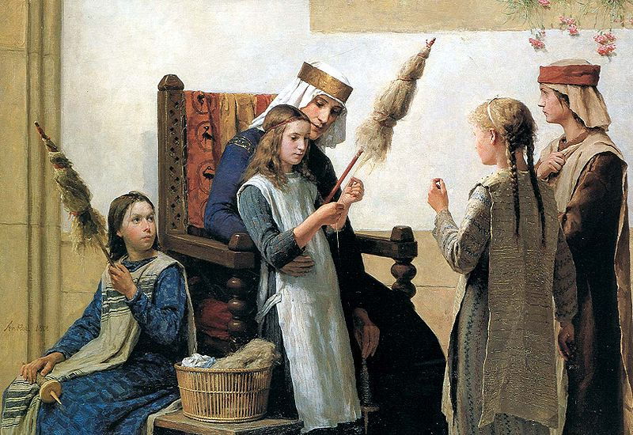
Girls dying wool in a dye house

Slide 13
Effects of the Cottage Industry
Big profits for new class of merchants
Alternative source of income for some peasants
Textiles become 1st industry in Industrial Revolution—Cottage Industry expands to Factory System (separate cottages brought under 1 roof)
http://www.history.com/topics/industrial-revolution/videos#the-autoloom-revolutionizes-textile-manufacturing
Capitalism
An economic system based on private ownership, free competition, and profit.
Cottage industry is an example of early capitalism

Slide 14
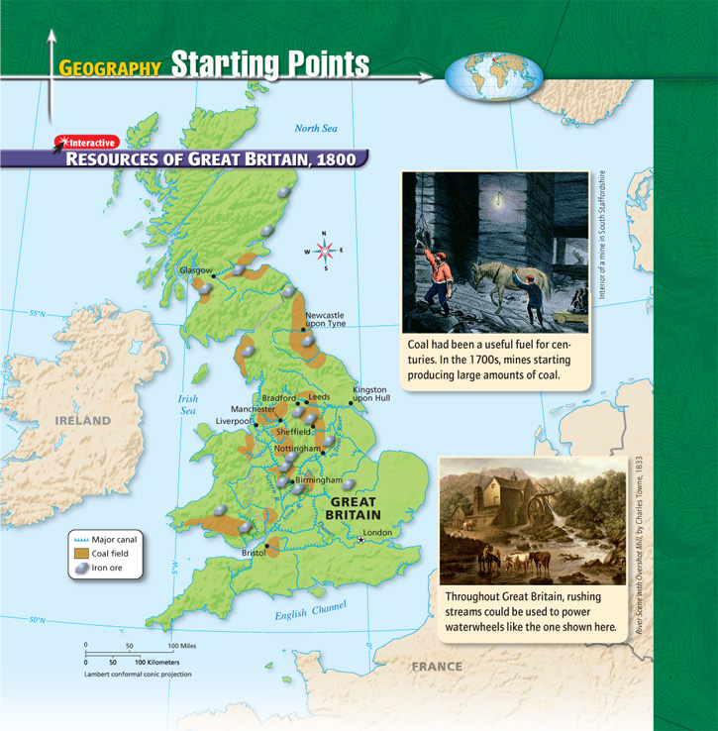
Why does the Industrial Revolution begin in Britain?

Slide 15
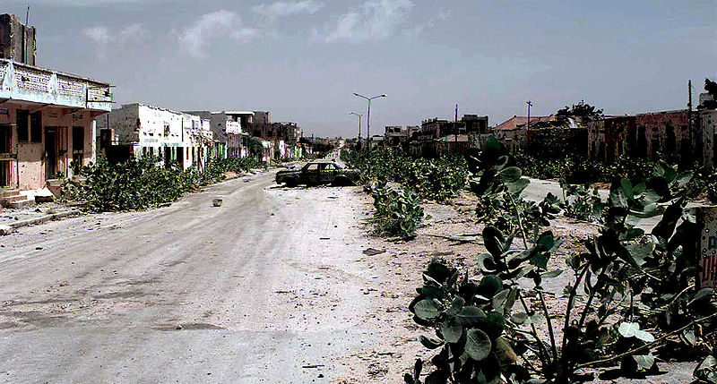
Why are some countries industrialized and others aren’t?

Slide 16
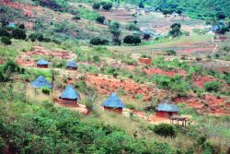

Slide 17


Slide 18


Slide 19
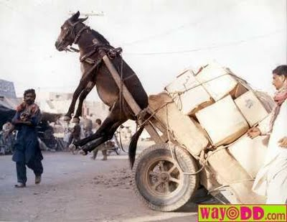

Slide 20
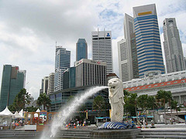

Slide 21


Slide 22
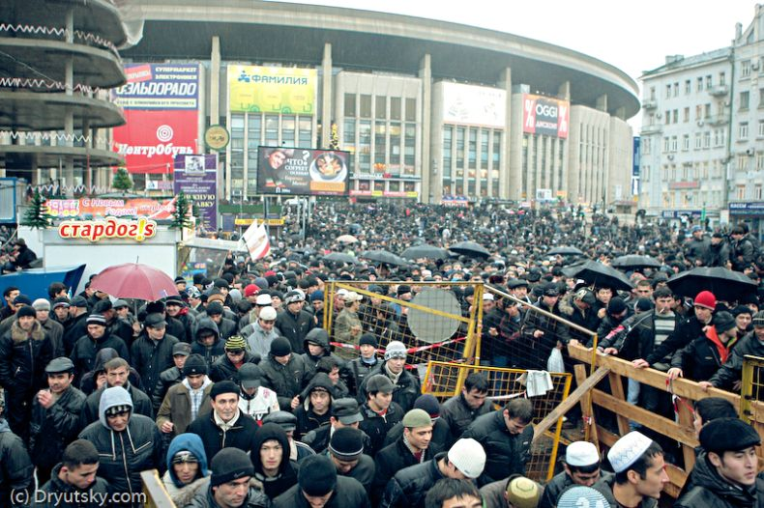

Slide 23
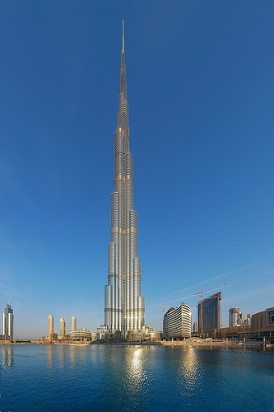

Slide 24

The Industrial Revolution began in Great Britain because of a favorable combination of resources, money and a large workforce
This combination of land (resources), labor (enough people for a large workforce), and capital (money needed to start an industry) are known as the
Factors of Production

Slide 25
Simple Machines Helping the Textile Industry
Problems faced by textile industry
Population growth = greater demand for clothing / textiles
Need machines to help produce more cloth
Cottages too small to hold big machines & more workers; inefficient taking materials to different cottages

Slide 26


Slide 27
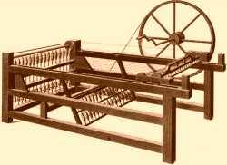
Hargreaves- invented Spinning Jenny. Machine that spun 8 times faster than a single wheel.

Slide 28
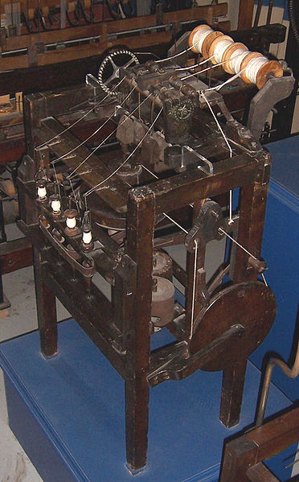
Arkwright- invented water frame (water powered spinning machines)

Slide 29
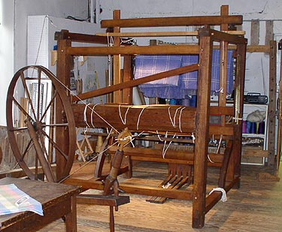
Cartwright- invented a water powered loom. One person could do the work of 800.

Slide 30
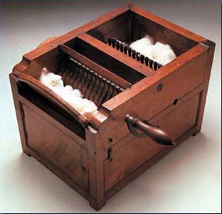
Eli Whitney- invented the cotton gin. This separated seed from cotton.

Slide 31
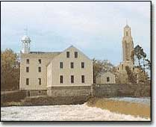
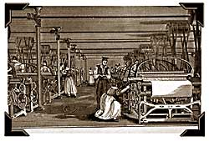
Rise of the Factory System
New machines, often too large for homes, were put into factories
Factories located near power source: coal, iron, and water
  Ever notice that most major cities are near water?

Slide 32
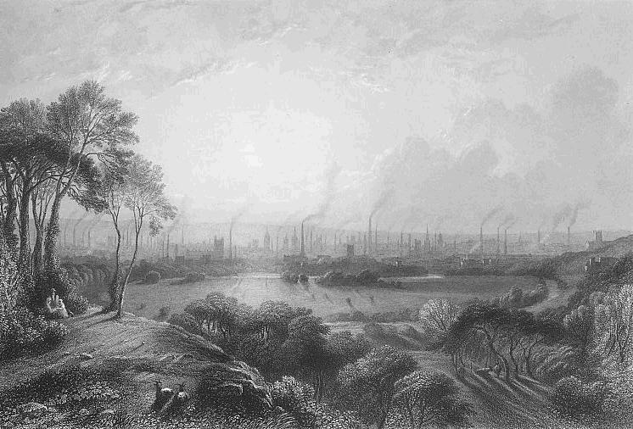
Effects of Textile Factories in Britain
Prices of mass produced textiles were much lower than hand produced products.
The majority of villagers were forced to leave farms to find work in urban factories, as farm labor was replaced by equipment

Slide 33
Steam Engine: The Need for Energy
Early factories relied on water mills and wind mills for power
Steam power evolved in response to the increasing need for power.
How the Watt Steam Engine worked
Steam forced from high to low pressure produces power.
James Watt patented the modern steam engine.

Slide 34
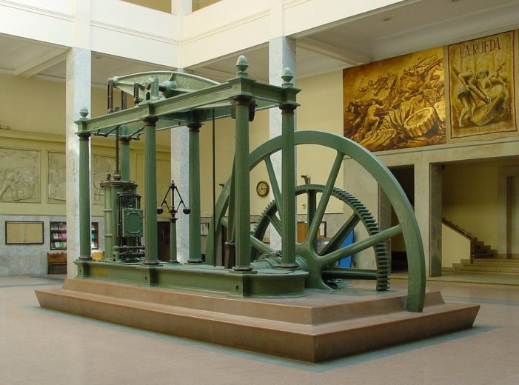
The Watt Steam Engine

Slide 35
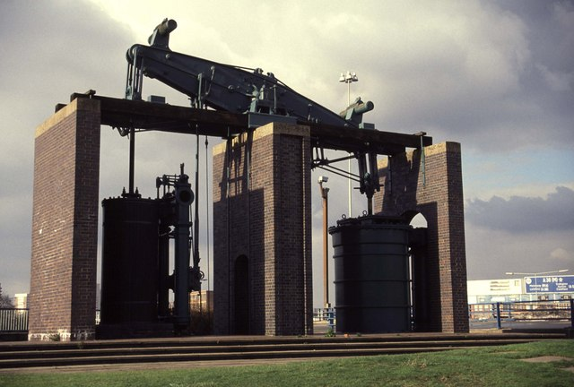
Effect of Steam Engine
Steam power, used wherever coal existed, increased textile production
Improved mining which in turn fueled other industries

Slide 36
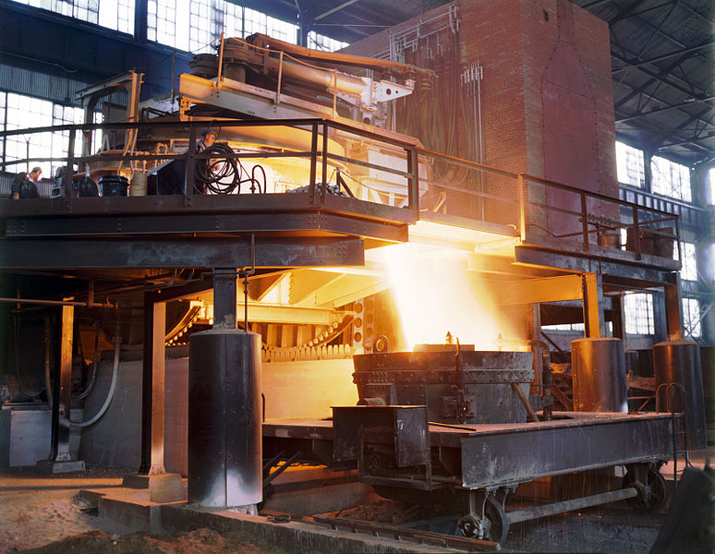
The need for Iron and Steel
Farming tools, new factory machines, railways made out of iron, then steel
Smelting makes iron ore more pure, but requires large amounts of carbon and heat
Bessemer process (Henry Bessemer) makes turning iron into steel more efficient—steel production goes up

Slide 37
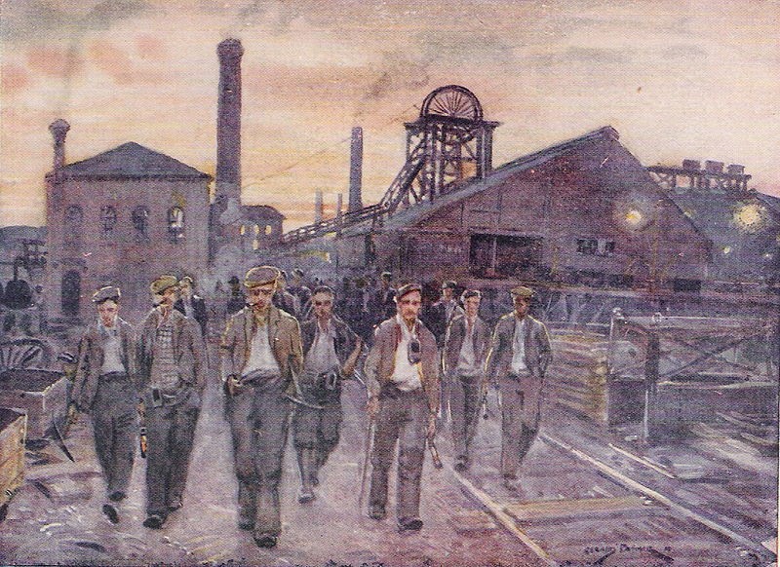
The Need for Coal
Coal is necessary for smelting iron
Steam engines powered by coal.
Effects of iron and coal
Britain produced more iron than all other countries in the world combined
Becomes wealthiest & most powerful nation of 1800’s

Slide 38
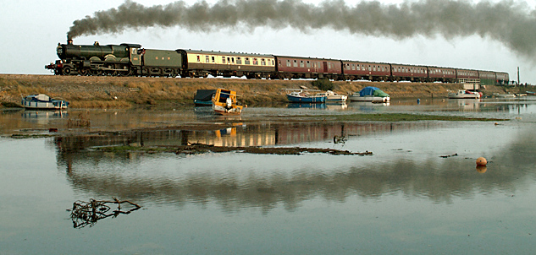
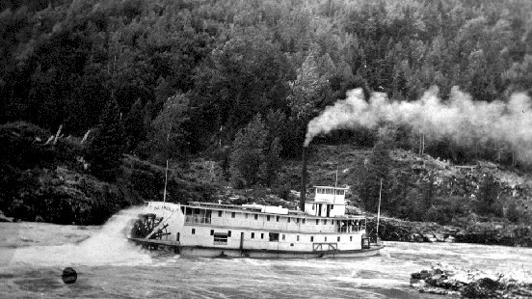
Transportation
Increased production of goods leads to a need for better transportation
New technologies make railroads, steam boats, and bridges possible

Slide 39
More Machines and Workers Needed.
Large Firm Reduces Orders for Iphones & Lays Off Workers
PROSPERITY
DEPRESSION
THE BUSINESS CYCLE
Employers Pay Less

Slide 40
More Machines and Workers Needed.
Factories Increase Orders for Iphones and Hire More Workers
Large Firm Reduces Orders for Iphones & Lays Off Workers
PROSPERITY
DEPRESSION
THE BUSINESS CYCLE
Employers Pay Less

Slide 41
More Machines and Workers Needed.
Factories Increase Orders for Iphones and Hire More Workers
Falling Demand for Goods
Large Firm Reduces Orders for Iphones & Lays Off Workers
PROSPERITY
DEPRESSION
THE BUSINESS CYCLE
Employers Pay Less

Slide 42
More Machines and Workers Needed.
Factories Increase Orders for Iphones and Hire More Workers
Falling Demand for Goods
Large Firm Reduces Orders for Iphones & Lays Off Workers
Iphone Supplies Cut Production & Lay Off Workers
PROSPERITY
DEPRESSION
THE BUSINESS CYCLE
Employers Pay Less

Slide 43
More Machines and Workers Needed.
Factories Increase Orders for Iphones and Hire More Workers
Falling Demand for Goods
Large Firm Reduces Orders for Iphones & Lays Off Workers
Iphone Supplies Cut Production & Lay Off Workers
PROSPERITY
DEPRESSION
Many Workers Competing for Jobs
THE BUSINESS CYCLE
Employers Pay Less

Slide 44
More Machines and Workers Needed.
Factories Increase Orders for Iphones and Hire More Workers
Falling Demand for Goods
Large Firm Reduces Orders for Iphones & Lays Off Workers
Iphone Supplies Cut Production & Lay Off Workers
PROSPERITY
DEPRESSION
Many Workers Competing for Jobs
THE BUSINESS CYCLE
Employers Pay Less
Workers Buy Less

Slide 45
More Machines and Workers Needed.
Factories Increase Orders for Iphones and Hire More Workers
Falling Demand for Goods
Large Firm Reduces Orders for Iphones & Lays Off Workers
Iphone Supplies Cut Production & Lay Off Workers
PROSPERITY
DEPRESSION
Many Workers Competing for Jobs
THE BUSINESS CYCLE
Employers Pay Less
Workers Buy Less
Prices Go Up to Cover the Cost of Production

Slide 46
More Machines and Workers Needed.
Factories Increase Orders for Iphones and Hire More Workers
Falling Demand for Goods
Large Firm Reduces Orders for Iphones & Lays Off Workers
Iphone Supplies Cut Production & Lay Off Workers
PROSPERITY
DEPRESSION
Many Workers Competing for Jobs
THE BUSINESS CYCLE
Employers Pay Less
Workers Buy Less
Rising Demand for Goods
Prices Go Up to Cover the Cost of Production

Slide 47
More Machines and Workers Needed.
Factories Increase Orders for Iphones and Hire More Workers
Falling Demand for Goods
Large Firm Reduces Orders for Iphones & Lays Off Workers
Iphone Supplies Cut Production & Lay Off Workers
PROSPERITY
DEPRESSION
Many Workers Competing for Jobs
THE BUSINESS CYCLE
Employers Pay Less
Workers Buy Less
New Factory Opens and Hires Many Workers
Rising Demand for Goods
Prices Go Up to Cover the Cost of Production

Slide 48
More Machines and Workers Needed.
Factories Increase Orders for Iphones and Hire More Workers
Falling Demand for Goods
Large Firm Reduces Orders for Iphones & Lays Off Workers
Iphone Supplies Cut Production & Lay Off Workers
PROSPERITY
DEPRESSION
Many Workers Competing for Jobs
THE BUSINESS CYCLE
Wages Go Up & People Buy More
Employers Pay Less
Workers Buy Less
New Factory Opens and Hires Many Workers
Rising Demand for Goods
Prices Go Up to Cover the Cost of Production

Slide 49
More Machines and Workers Needed.
Factories Increase Orders for Iphones and Hire More Workers
Falling Demand for Goods
Large Firm Reduces Orders for Iphones & Lays Off Workers
Iphone Supplies Cut Production & Lay Off Workers
Production Increases to Meet Demand
PROSPERITY
DEPRESSION
Many Workers Competing for Jobs
THE BUSINESS CYCLE
Wages Go Up & People Buy More
Employers Pay Less
Workers Buy Less
New Factory Opens and Hires Many Workers
Rising Demand for Goods
Prices Go Up to Cover the Cost of Production

