Slide 1
The enlightenment
The Thinkers

Slide 2
enlightenment
What was it?
What were it’s characteristics?
What changes did it create?
How does it affect you?

Slide 3
Traditional (pre-Enlightenment) Thought | Enlightenment Thought
The universe is mysterious. A common person cannot understand the natural world | The universe is fundamentally rational, that is, it can be understood through the use of reason alone
A king/ruler has been put in power by God, and his/her authority is absolute. | A government is only in power by the will of the people being governed.
Common people need an educated, religious authority to explain the truth to them. | Human experience is the foundation of human understanding of truth; authority is not to be preferred over experience.
There is no connection between rules that govern the natural/animal world, and rules that govern human society. The same rules cannot be applied to both. | Since the natural world is governed by certain scientific laws, so too should the human world be governed by basic laws.
Human history repeats and simply reinforces tradition | Human history is largely a history of progress
Education is only an option for select people; common people should follow in the footsteps of their ancestors. | Human beings can be improved through education and the development of their rational facilities
The best way that we can understand the nature of the universe is by relying on religious belief and tradition. | Religious belief and tradition should be challenged and scientifically tested to see if they are true

Slide 4
Word of the day
Natural
Enlightenment thinkers believed in
Natural Law
Use of reason to analyze human nature
Natural Rights
We’ll get to those

Slide 5
Term of the day
Social Contract
Well, what is it?

Slide 6
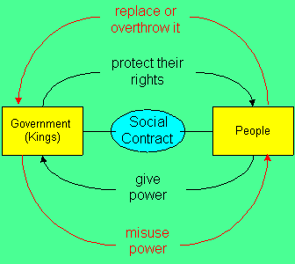
Social contract

Slide 7
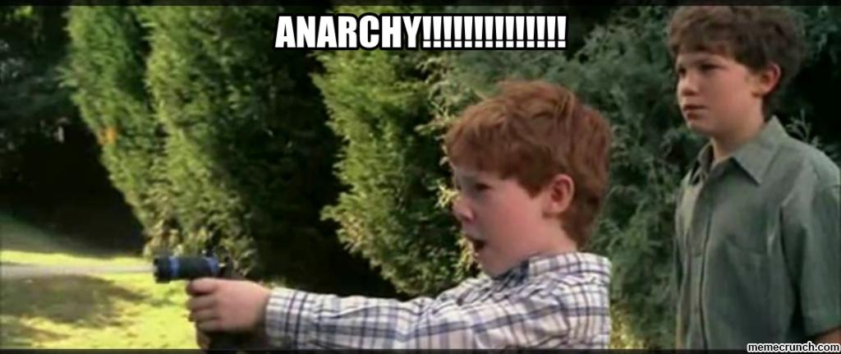
Social contract
At first, people lived in anarchy.
No rules! We do what we want, old man!

Slide 8
Social contract
Anarchy was a little dangerous and violent.
To avoid these pitfalls, people choose a ruler.
The people and ruler agreed to an unwritten Social Contract.
Social Contract: An agreement between the governed and the government defining and limiting the rights and duties of each.

Slide 9
philosophes
Term for the thinkers of the Enlightenment
Most of our Enlightenment Hall of Fame consists of philosophes

Slide 10
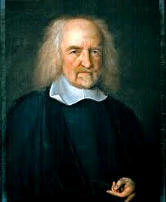
Thomas hobbes

Slide 11
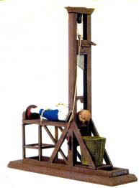
Thomas hobbes
Philosophe/Author
Lived through the English Civil War
Didn’t like the chaos and violence it created
People must give up freedoms in order to promote orderly society

Slide 12
Thomas hobbes
People only retained the right to protect their own lives. Everything else is given up to ruler.
Favored a strong monarch to maintain order.
Remember, he didn’t like the English Civil War

Slide 13
Thomas hobbes
Believed people act out of their own self-interest, with little regard for others.

Slide 14
Thomas hobbes
Only the strong survive, so the absolute power of a strong ruler is needed to maintain order.

Slide 15
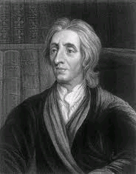
John locke

Slide 16
John locke
Philosophe/Author
Also lived through English Civil War
Believed no ruler should have absolute power
It goes against the laws of nature for one creature to rule over another

Slide 17
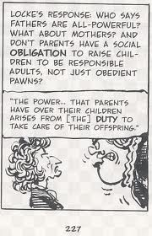
John locke
Accepted the Social Contract but…
People only gave up some of their rights and freedoms

Slide 18
John locke
Government is created with the consent of the governed
Government should protect people’s rights
Including the Right to Party, according to Ye Olde Beastie Boys

Slide 19
John locke
Believed we maintained three natural rights
Life
Liberty
And…
Spoiler Alert: Government can still take these things away

Slide 20
John locke
Believed we maintained three natural rights
Life
Liberty
And…
Property
Spoiler Alert: Government can still take these things away

Slide 21
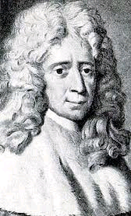
Baron de montesquieu

Slide 22
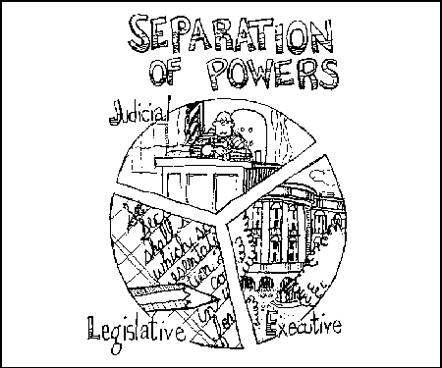
Baron de Montesquieu
French philosophe/author
Believed it is dangerous for all governmental power to be held by one person/branch
Separation of Powers

Slide 23
Baron de montesquieu
The best form of government has powers divided among legislative, executive and judicial branches
Separation of powers creates…
Checks and balances
U.S. example: Congress can pass a law but the president can veto that law and the Supreme Court can declare that law unconstitutional

Slide 24
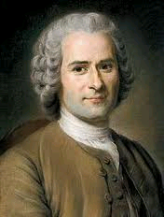
Jean jacques rousseau

Slide 25
Jean jacques rousseau
People are naturally good but are corrupted by society
People want to choose their government
Called for popular sovereignty – government is created and controlled by the people
Direct Democracy
Opposed any monarchy

Slide 26
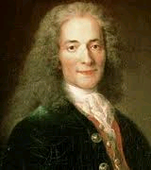
voltaire

Slide 27
voltaire
French writer
Wrote satires criticizing the French monarchy
Imprisoned twice for criticisms
People should have the right to freedom of speech, expression or thought

Slide 28
voltaire
“I may disagree with what you say but I will defend to the death your right to say it.”
Also believed, people should have freedom of religion and practice religious toleration
Willing to put up with someone’s practicing of a different religion than their own

Slide 29
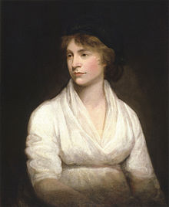
Mary wollstonecraft

Slide 30
MARY WOLLSTONECRAFT
Argued for the equality of women with men
Women should have the same educational opportunities as men
Women should have the same political rights as men
Suffrage – right to vote

Slide 31
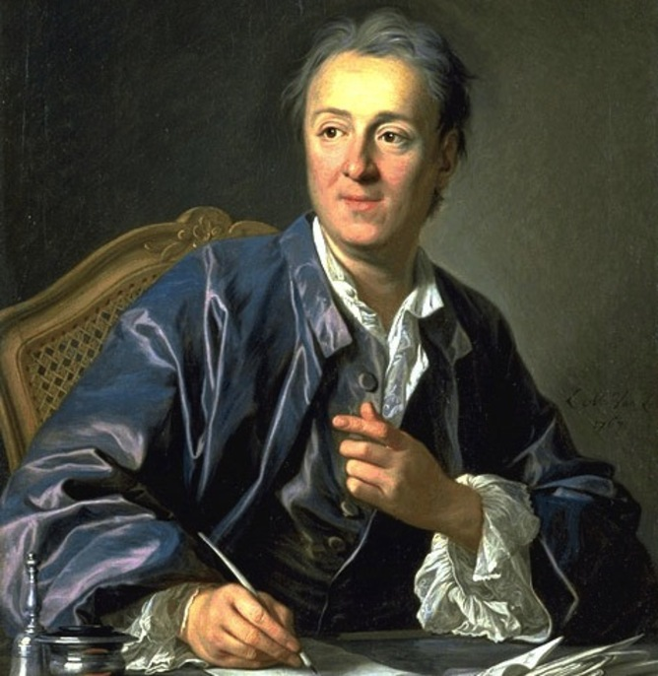
Diderot

Slide 32
Diderot
Created the Encyclopedia
Classified Dictionary of the Sciences, Arts & Trades
28 volume collection of knowledge
Attacked religious superstitions
Supported religious toleration
Sold to upper class, it spread Enlightenment ideas

