Slide 1
WWI

Slide 2
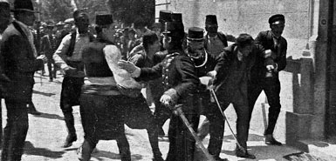
Causes of WWI
http://www.history.com/videos/causes-of-world-war-i#causes-of-world-war-i

Slide 3
Underlying causes of WWI
Imperialism Rivalries
* 2 countries compete over something
* Competition over land and colonies causes conflict, countries build up their military
Alliances
* A partnership of cooperation between 2 or more countries
* Countries become bound to helping other countries and get involved in conflict through alliance treaties
World
War I
Nationalism
* Extreme patriotism—desire for your country to be the most powerful. Love of one’s country over region.
* Ethnic groups try to gain political unity.
Militarism
* Glorification of armed strength. Building up the military.
* All countries build up armies for self-defense, leads to an expectation of war.

Slide 4
Opposing Alliances
Britain
Russia
Austria-Hungary
Germany
Triple
Entente
1907
Triple
Alliance
1882
France
Italy

Slide 5
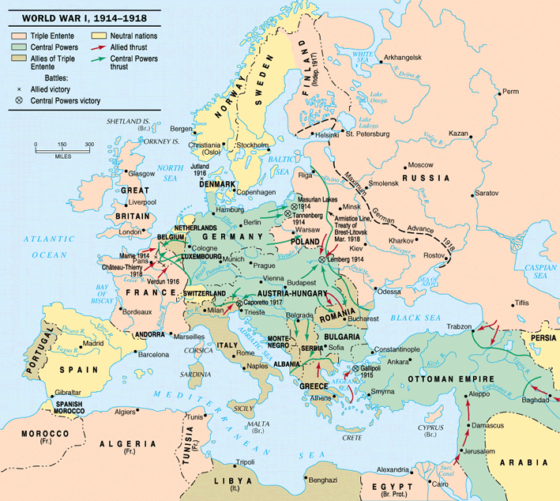
Looking at the map on pg. 508, you see that the countries of the Triple Entente are divided geographically—Great Britain and France are in Western Europe, but Russia is in Eastern Europe. THINK!!:
How could this be a DISADVANTAGE for the countries of the Triple Entente?
Can’t share supplies and troops
How could this be an ADVANTAGE for the countries of the Triple Entente?
Make Triple Alliance fight a two-front war

Slide 6
The Balkan “Powder Keg”
Serbia became independent from the Ottoman Empire in 1878.
  Serbian Nationalists there wanted to add the states of Bosnia and Herzegovina to their country. However, these 2 states were protectorates of Austria-Hungary.
  Terrorist groups, such as the Black Hand, became active in the Balkan states against Austria-Hungary.
Russia supported the movement of Pan-Slavism, which tried to unify all Slavic nations to achieve cultural and political unity.

Slide 7
Why were the Balkan states called a “powder keg”?
  A powder keg refers to a barrel of gunpowder. Will explode if there’s a spark!
  How is this metaphor true?
  With all of the tension in the region, one small conflict could ignite war.

Slide 8
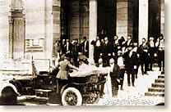
The spark that ignites WWI
The prince of Austria-Hungary, Archduke Francis Ferdinand, was visiting Sarajevo, the capital of Bosnia and Herzegovina.
  Riding in an open car in a parade when a Serbian nationalist, Gavrilo Princip, assassinated he and his wife—ran up to the car and shot them.
SYSTEM OF ALLIANCES KICKS IN

Slide 9
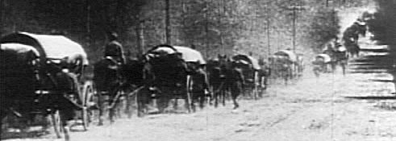
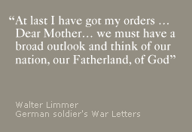
Explosion
After the assassination of Archduke Ferdinand, none of the leaders of the major European powers showed a willingness to avoid war
Millions of Europeans saw war as a way to gain honor for themselves and glory for their country

Slide 10
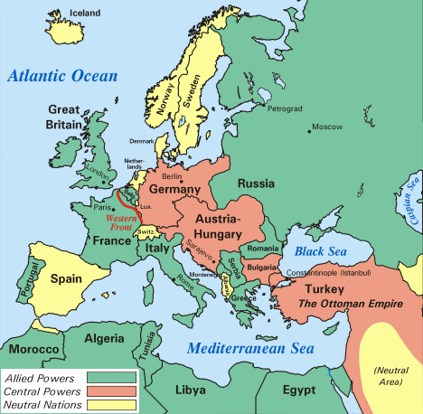
Mobilization in Europe
Belligerents = Warring nations
  July 28 1914: A/H → Serbia
  Aug. 1 1914:Germany → Russia
  Aug. 3 1914: Germany → France
  Aug. 4 1914: G.B. → Germany
Japan joined Allies in August
Ottoman Empire joined Central Powers in October 1914
Italy joined Allies in May 1915

Slide 11
Two Sides
Central Powers
Allied Powers
German Empire
Austria-Hungary
Ottoman Empire
Bulgaria
Great Britain
France
Russia (until 1917)
Japan
Italy (1915)
US (1917)
http://www.history.com/topics/battle-of-the-somme/media#wwi-firsts

Slide 12
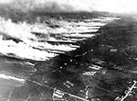
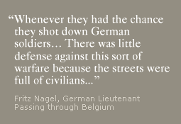
1914: War and Stalemate
“Paris for lunch, St. Petersburg for dinner”
- Kaiser Wilhem II
Both sides believed the Great War would be over by Christmas, 1914
Germany’s Schleiffen Plan called for attacking & defeating France before Russia was even mobilized for war.
Germany invades Belgium to get to France—August 4, 1914. Belgian civilians shot at German soldiers; German military responds with first poison gas attack.
On the Eastern Front, Russia invaded Germany, hoping to catch them off guard.
The Battle of Tannenberg (Aug. 26-30) was disastrous for Russia
Poison gas attack on Flanders, Belgium. 1914, 1st battle of WWI
"The Russian commanders were trying to stop the German war machine simply by throwing at it a mountain of human bodies.”
  Interrupted German invasion of France, allowing British to arrive in time to help, but Russia lost as many as 250,000 troops at Tannenberg

Slide 13
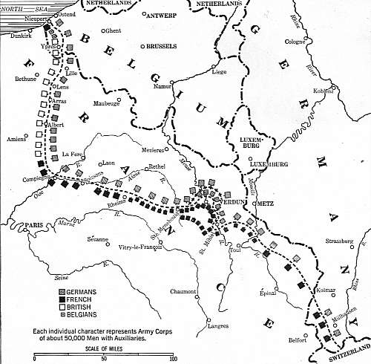
Beginnings of Trench Warfare
When the British & French stopped the German invasion at the Battle of the Marne (Sept. 1914), the stalemate began.
A line of trenches eventually stretched along the Western Front from the Alps to the English Channel.
http://www.history.com/videos/trench-warfare#trench-warfare
I've a Little Wet Home in a Trench
I've a little wet home in a trench
Where the rainstorms continually drench,
There's a dead cow close by
With her feet in towards the sky
And she gives off a terrible stench.
Underneath, in the place of a floor,
There's a mass of wet mud and some straw,
But with shells dropping there,
There's no place to compare,
With my little wet home in the trench.
Folklore song which originated from life in the trenches.
Sung to the tune of My Little Grey Home in the West.

Slide 14
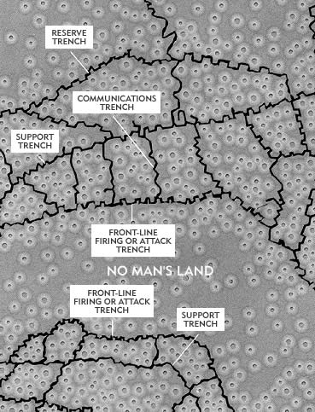
Trench Facts
The Trench System
Each battalion had its own supply of rum that it distributed to its soldiers. Each division of 20,000 men received 300 gallons.
Every soldier carried iron rations -- emergency food that consisted of a can of bully bee, biscuits and a tin of tea and sugar.
A single pair of rats could produce up to 880 offspring in a year.
A total of 3,894 men in the British Army were convicted of self-inflicted wounds. A firing-squad offense -- none were executed, but all served prison terms.
The British Army treated 20,000 soldiers for trench foot during the winter of 1914-15.
One-third of all casualties on the Western Front occurred in a trench.
A lit candle was fairly effective in removing lice, but the skill of burning the lice without setting yourself on fire was difficult to learn.
Soldiers in the trenches often depended on impure water collected from puddles in the trench, causing dysentery.

Slide 15
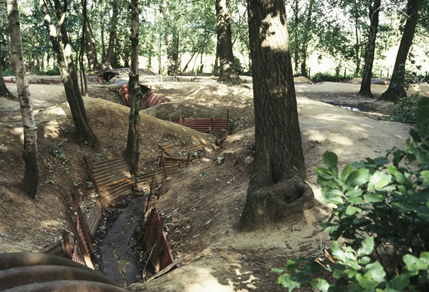
Trench Warfare Photo Gallery
Trenches near Ypres: In the fall of 1914, British soldiers took refuge near Ypres, Belgium, naming the area "Sanctuary Wood."

Slide 16
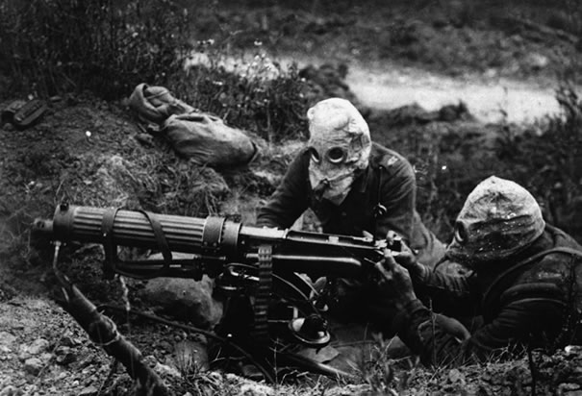
Trench Warfare Photo Gallery
Battle of the Somme, 1916: In just the first day of the Battle of the Somme, the British Army suffered more than 60,000 causalities, and by the end of the offensive more than 420,000 had been killed.

Slide 17
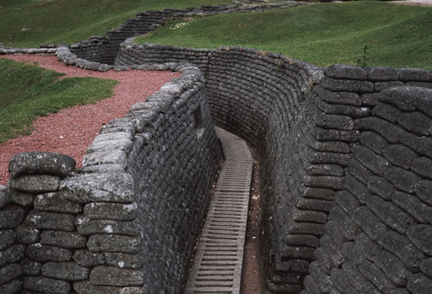
Trench Warfare Photo Gallery
World War I Trench at Vimy: In April 1917, Canadian forces defeated the heavily entrenched Germans near Vimy, France. Today, the remnants of the German defenses have been preserved with concrete.

Slide 18
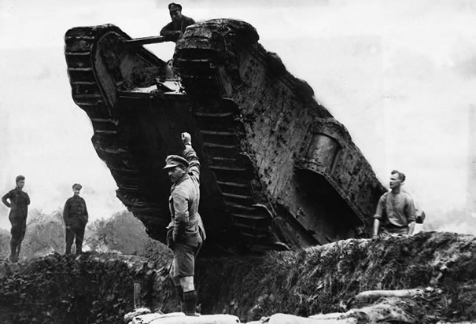
Trench Warfare Photo Gallery
British Tank Rolling over Trench: Members of the British Royal Navy maneuver a tank, or "landship," over a trench during the 1917 Battle of Cambrai, one of the first successful uses of the tank in World War I.

Slide 19
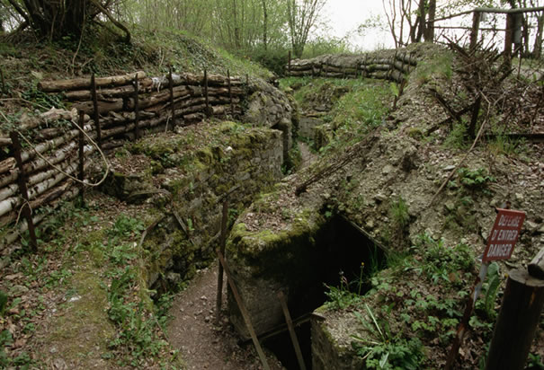
Trench Warfare Photo Gallery
German Trench and Bunker near Verdun: For nearly four years, the Allies and Germany fought over the Butte de Vauquois. The battles included a deadly series of attacks in which more than 500 mines were exploded beneath trenches, tunnels and buildings in the town.

Slide 20
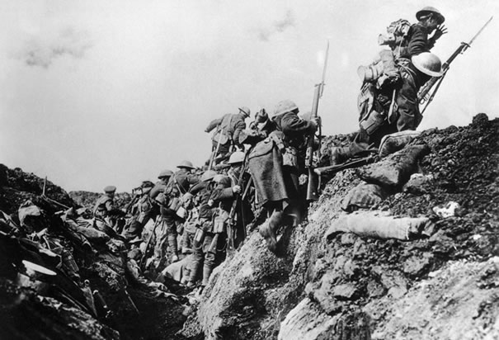
Trench Warfare Photo Gallery
Canadian Soldiers Going into Action From Trench: A company of Canadian soldiers go "over the top" from a World War I trench.

Slide 21
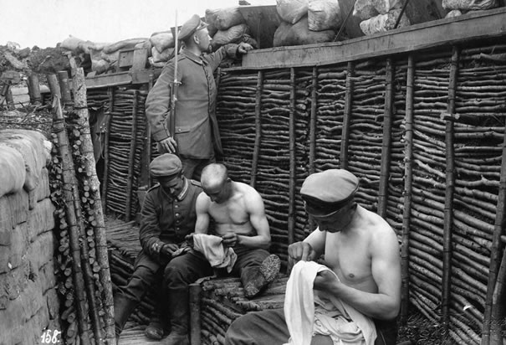
Trench Warfare Photo Gallery
Soldiers Picking Lice from Clothes: Conditions in the trenches were miserable, with rampant dirt, vermin and disease.

Slide 22
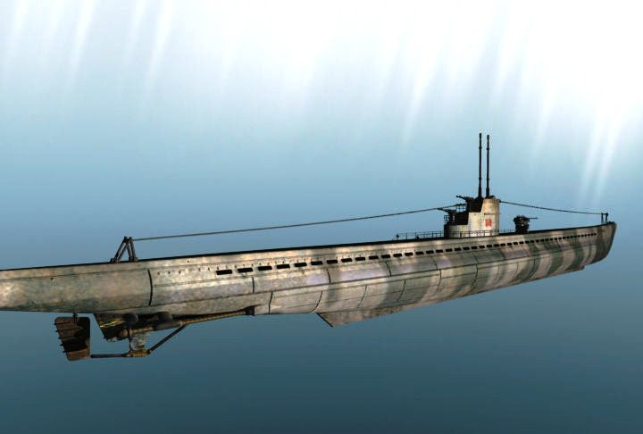
Advances in Technology
German U-Boats (Unterseebooten )—early submarine
      Two Hulls →
        Inner hull protected from pressure of sea
        Outer hull fit around it, leaving space between the two so it can rise or sink

Slide 23
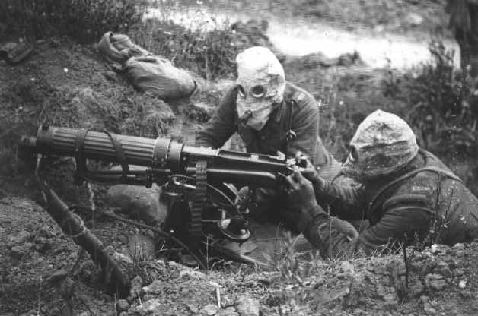
Advances in Technology
Machine Guns
  Fired rapidly, without interruption
  First ones were heavy → Had to have a team of several men to operate them
  Caused huge causalities
Chemical Warfare
  Germans introduced
  poison gas as a weapon
  Gas masks & chemical
  suits invented in response

Slide 24
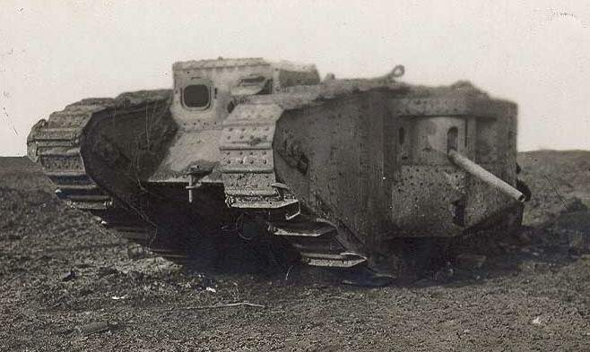
Advances in Technology
In 1916, Britain introduced the tank—helped end trench warfare

Slide 25
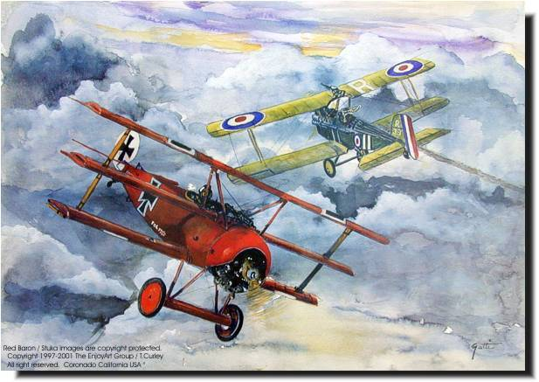
Airplanes as Weapons
In the first year of WWI, planes were mainly used for observation
  Gave valuable bird’s-eye view of battlefield
  Planes would shoot at each other using rifles & pistols
Invention of the “interrupter”—French mount machine gun to nose of airplane in 1915
Manfred von Richthofen (“The Red Baron”) of Germany → Shot down around 80 enemy planes

Slide 26
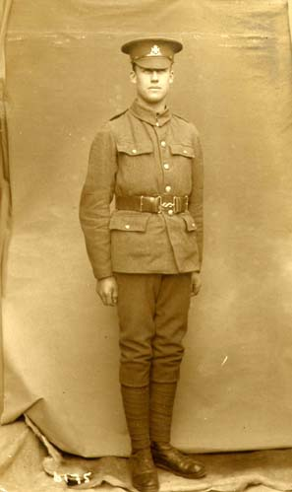
A New Army
Types of soldiers changed
  No longer “professional” soldiers
  Drafted civilians or used inexperienced volunteers
Men and women at home supported war effort by working in factories to produce weapons
  “Total War” → When a nation turns all of their resources to the war effort

Slide 27
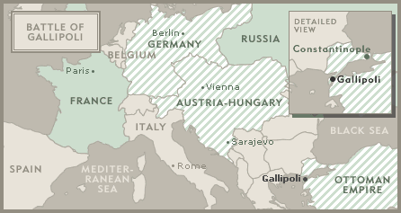
1915
The war spreads to other continents & becomes global with the Allied invasion of Gallipoli
Invasion was unsuccessful; 46,000 Allied soldiers dead
Turkish massacre/genocide against Armenians kills more than 1 million civilians.
http://www.history.com/topics/world-war-i/videos#allies-launch-disastrous-attack-at-gallipoli
The war at Gallipoli, for Turks, is a holy war. We are fighting for the sake of Allah, for the favor of God, and for the protection of the homeland.
- Hasan Etem, Turkish soldier

Slide 28
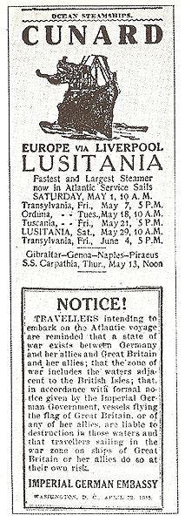
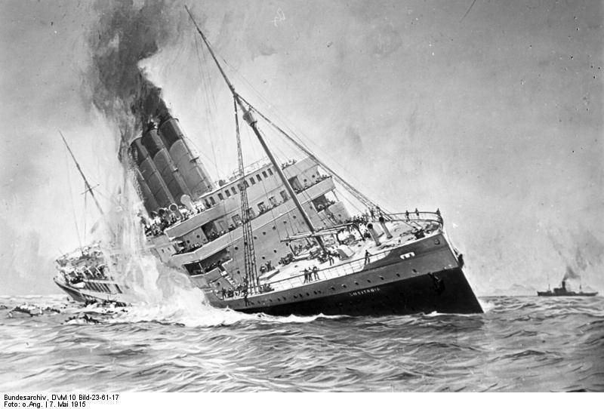
Sinking of the Lusitania
Germany discovered that the Allies were smuggling weapons on passenger/civilian ships, assuming German U-boats would not attack a ship with civilians on it.
Germany warned people in Britain not to go on cruise ships that would be crossing the Atlantic Ocean.
The Lusitania had departed from Liverpool, England and sailed to New York. It was sunk by a U-boat on its return trip to England.
Over 1,100 people were killed (mostly British), 128 of which were Americans
The Lusitania was indeed secretly carrying weapons.
http://www.history.com/videos/causes-of-world-war-i#u-boats-sink-the-lusitania-in-1915

Slide 29
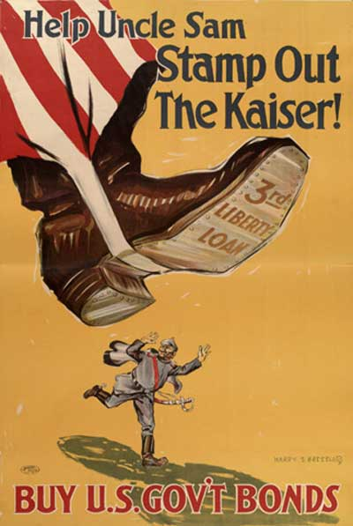
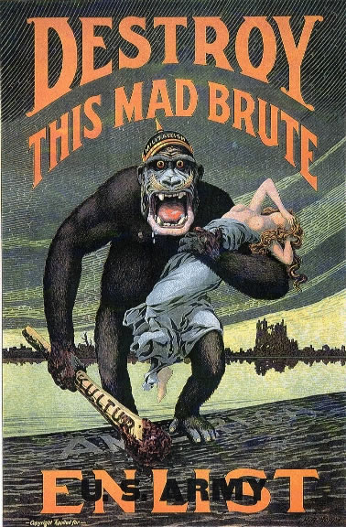
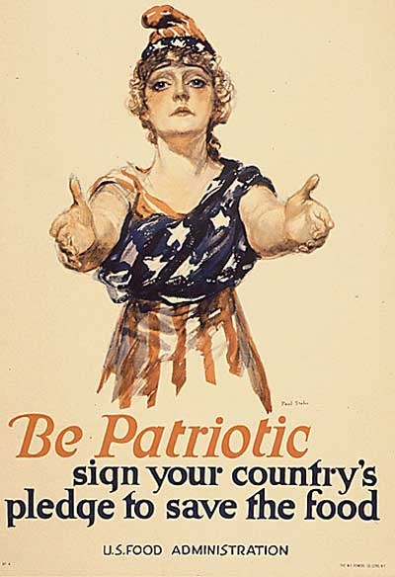
Propaganda → Use of selected information
  Both true and false
  Governments sent up agencies to control news about the war
Atrocities → Brutal acts against defenseless civilians
  British stories of German atrocities angered Americans
  Did not realize the stories were exaggerated

Slide 30
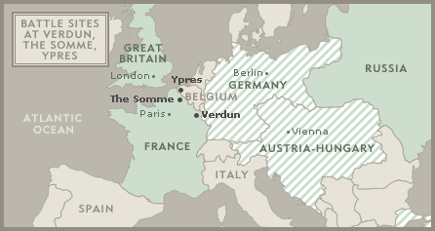
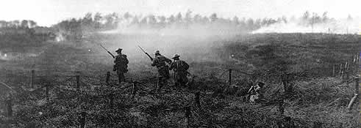
1916—1917: Many Deaths, Few Gains
The battles on the Western Front in 1916 were some of the deadliest of the war.
Verdun (Feb.-Dec. 1916) resulted in over 300,000 deaths. The French turned back Germany’s attempted invasion.
The Somme (July-Nov 1916) resulted in over 1 million deaths, in a failed British attempt to attack the German trenches.
http://www.history.com/topics/battle-of-the-somme/media#1916-battle-of-the-somme
The 3rd Battle of Ypres (Aug-Nov 1917) fought in pouring rain, results in 700,000 combined casualties & no territory gained.

Slide 31

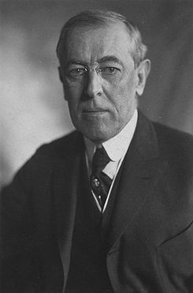
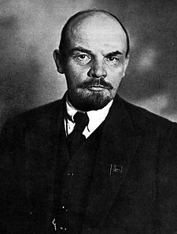
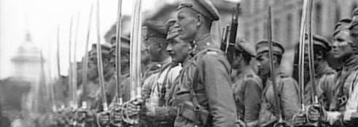
1917—Mutiny, Rebellion, and the Fight for Democracy
The United States declares war on Germany April 6, 1917.
- “Zimmerman Telegram”, proposing alliance between Germany & Mexico, intercepted by US spies
- Germany continues “unrestricted submarine warfare”, sinking US cargo ships bound for Britain
Czar Nicholas II of Russia abdicates in March. New democratic government stays in war, however; loses support of the Russian people.
Communists, led by Vladimir Lenin, revolt in November. Russia withdraws from WWI in December.
In April, after another failed attack resulted in 250,000 French casualties, French soldiers mutiny (“go on strike”), demanding that their commanders conduct the war differently.

Slide 32
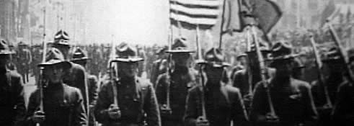
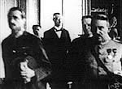
1918: Collapse of the Central Powers
American soldiers marching to battle
German officers after signing the armistice
In 1918, both sides were running out of soldiers, drafting old men and young boys.
Germany launches offensive in March to try to end war before US troops arrive. Germans get near Paris, but US soldiers arrive to help turn back attack at Chateau-Thierry in June.
Counter-offensive leads to German retreat. German soldiers begin refusing to fight; German civilians revolt in October as Allied army crosses into Germany
Kaiser Wilhelm II abdicates German throne; armistice (agreement to stop fighting) is signed Nov. 11, 1918.

Slide 33
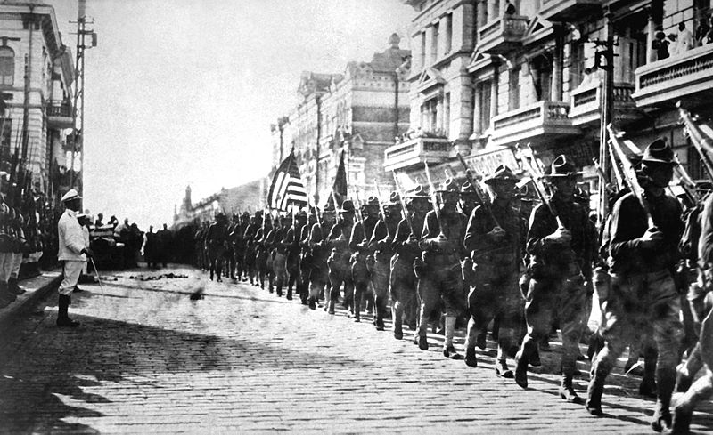

War Without End
Allies kept blockade in place until June 1919 to pressure Germany into agreeing to terms of treaty; thousands more German civilians die from starvation
Allies (including US) send some troops to fight in Russian Civil War against Communists.
Flu pandemic kills millions worldwide 1918-19; more died from flu than from WWI battles.
US troops march in Vladivostok, Russia-1918

Slide 34
Fourteen Points
President Wilson outlined a set of ideas for improving world relations
  14 Points → 6 were generalized, 8 dealt with specific countries
    No secret treaties
    Freedom of the seas for all nations
    Removal of all economic barriers, such as tariffs
    Reduction of national armaments
    Adjustment of colonial claims so they were fair to both imperialist powers and colonial people
    Establishment of “a general association of nations” to guarantee political independence and protection to small and large states alike

Slide 35
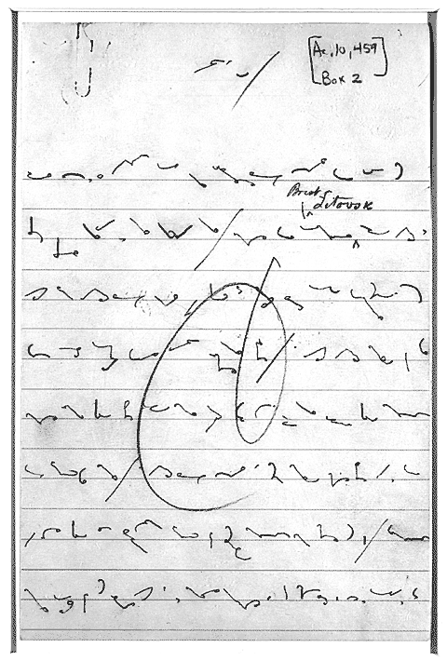
Wilson’s Notes

Slide 36
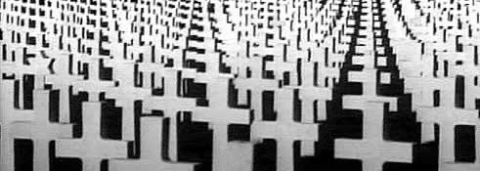
The Cost of War
Which Allied Power suffered the most casualties?
Which Central Power suffered the most casualties?
What was the total number of soldiers killed in WWI?
http://www.pbs.org/greatwar/resources/casdeath_pop.html

Slide 37
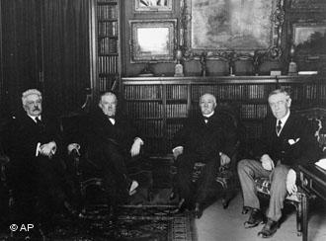
Paris Peace Conference
The Big 4
  U.S. President Woodrow Wilson
  British Prime Minister David Lloyd George
  French Premier Georges Clemenceau
  Italian Prime Minister Vittorio Orlando
        Met at Versailles

Slide 38
Treaty of Versailles
May of 1919 → Dealt harsh punishments to Germany
Forced to pay reparations
  Reparations → Payments for war damages
Divided up large parts of Germany
  Alsace-Lorraine returned to France
  Belgium gained territory
  Poland was restored to a independent nation
Military
  No Draft
  Army of just 100,000
  Navy hurt
    Could not be enforced

Slide 39
Treaty of Versailles
http://www.history.com/videos/treaty-of-versailles-end-world-war-i#treaty-of-versailles-end-world-war-i

Slide 40

League of Nations
Had two main goals:
  Promote international cooperation
  Keep peace among nations, settled disputes and reducing armaments
World Court
  Determine cases involving international law
  5 permanent members → G.B., France, Italy, Japan, & U.S.

Slide 41
League of Nations
Agreed not to go to war
  If there was a disagreement → submit a dispute to the World Court
  Economic Sanctions → Would be placed on a country found breaking diplomatic relations
    Military force was a last resort
Mandates → Colonies of defeated countries would be ruled by “advanced” nations
  Ruling countries would promise to prepare colonial people for independence
U.S. never joined
  Citizens feared being dragged into another war

Slide 42

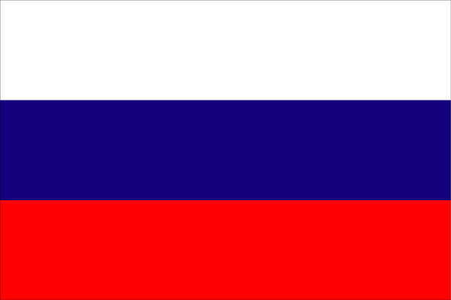

ALLIED
TRENCH

Slide 43


CENTRAL
POWERS’
TRENCH

Slide 44
NO
MAN’S
LAND

Slide 45

CROSS
IF YOU
DARE!

